Slide 1
Conceptual
Database Design

Slide 2
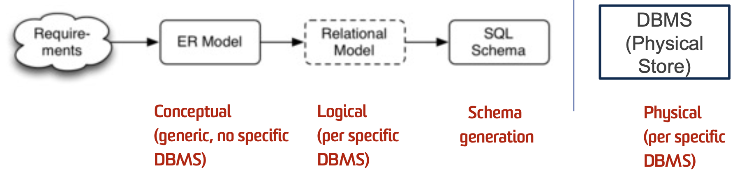
Data Modelling
Kinds of data models:
conceptual: abstract, high-level data model, e.g., ER, ODL (object data language) – user friendly
logical: concrete, for implementation in specific DBMS, e.g., relational
physical: internal file storage (inside a specific DBMS)
Strategy: design using abstract model; map to logical model, DBMS takes care of the physical model

Slide 3
Recall the Following Stages
Conceptual Design
Logical Design
Physical Design

Slide 4
Scenario
A: “Welcome to the job, can you build us a database to organize all the information on a publisher and present it at the meeting?”
B: “okay, what’ll be in the database?”
A: “Well… authors, books, editors, printers etc. An author can write zero or more books and a book is written by one or more authors. Where a book is uniquely identified by its book-id. For each book, we also record its title, price, and availability. An editor is uniquely identified by his/her reader-id and we also record his/her name, phone number, address. The address is composed of street and suburb…”

Slide 5
The Application
“An author can write zero or more books and a book is written by one or more authors. Where a book is uniquely identified by its book-id. For each book, we also record its title, price, and availability. An editor is uniquely identified by his/her reader-id and we also record his/her name, phone number, address. The address is composed of street and suburb…”
This is the application we need to design the design for; the application has a set of requirements.
Requirements Collection & Analysis

Slide 6
Simplified Database Workflow
What should we do?
Application: has many requirements
Database Schema: provides a logical view of data model
?
Application
Database
Schema

Slide 7
Simplified Database Workflow
More Generally, how should everyone build his/her databases for an application for its given requirements?
Database Schema: provides a logical view of data model
Application A
Database
Schema X
?
Application B
Database
Schema Y
?
Database
Schema Z
Application C

Slide 8

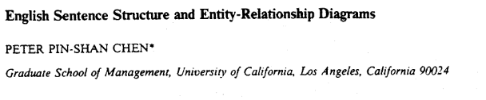
Solution
Dr. Peter Chen
https://www.csc.lsu.edu/~chen/
His work (in 1976) started a new field of research and practice:
Conceptual Modeling
See paper on the Entity-Relationship Model in link
https://bit.csc.lsu.edu/~chen/pdf/english.pdf

Slide 9
Solution
Conceptual
Modeling
Database
Schema
Application
(Chen. 1976)
Entities
Relationships
Attributes

Slide 10
Entity-Relationship Model
Chen’s ER model has two major components:
    Entity: collection of attributes describing object of interest
    Relationship: association between entities (objects)
There’s also the third components unofficially
    Attribute: data item describing a property of interest
Note: The ER model is not a standard, so many variations exist. Lecture notes use simple notations.

Slide 11
ER Diagrams
Entities and their attributes can also be described with Entity-Relationship Diagrams (ERDs). e.g.
Registration
Number
State
Registration
CAR
Colour
Make
Model
Year

Slide 12

Entity
“Entities represent things in the real world, and attributes describe properties of entities.”

Slide 13
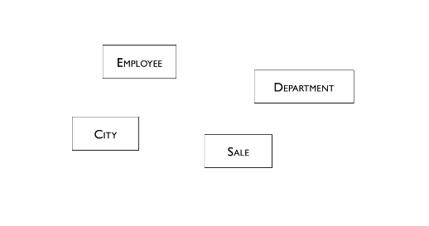
Entities
Some examples of entities (in a company)

Slide 14
Simple Attributes
Simple Attributes (or Atomic Attributes) are attributes that are not divisible.
Each simple attribute of an entity type is associated with a value set (or domain of values), which specifies the set of values that may be assigned to that attribute for each individual entity.
For example:
  Entity = Student
  Attributes = Student number, name…
Student A:
  Student number = z12345678
  Name = Bob
  …

Slide 15
Multi-Valued Attributes
Attributes can also be multi-valued
  Multivalued: has more than one value
  No longer a simple attribute with only one value.
Questions:
  Each simple attribute is meant to hold one value, sure it can change… but one value at a time.
    What if… I’m asking you to model shirts with two colours?
    How can we model this without multivalued attributes?

Slide 16



Problem
Do we need multi-value attributes?
The attributes you design should be able to describe, and the combinations of all its instances should be able to express the entity faithfully
Example: more expressively model the attribute colour for entity shirt.

Slide 17
Composite Attributes
Recall what is a simple attribute? Attributes that are not divisible are called simple or atomic attributes.
Composite attributes can be divided into smaller subparts, which represent more basic attributes with independent meanings.
Some semantics cannot be captured using atomic attributes

Slide 18
Question:
Question: is Address a simple attribute/value?
  Address = ‘Computer Science Building (K17), Engineering Rd, UNSW Sydney, Kensington NSW 2052”
How can should we model Addresses ?

Slide 19
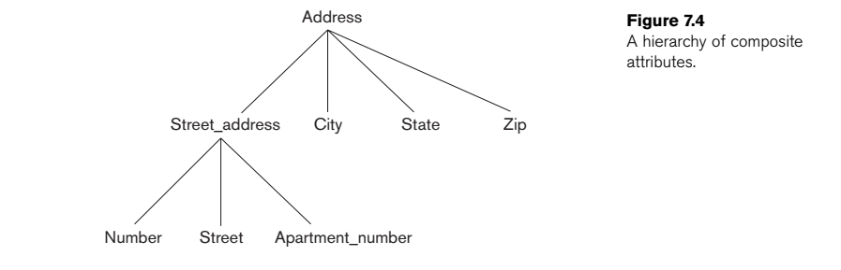
Question:
Question: is Address a simple attribute or a composite attribute?
  Address = ‘Computer Science Building (K17), Engineering Rd, UNSW Sydney, Kensington NSW 2052”

Slide 20
Question:
Composite attributes are useful for situations when
  The end-user sometimes refers to the composite attribute as a unit,
  But at other times refers specifically to its components.
Question: Can’t I just let my composite attributes, be simple attributes instead?

Slide 21
Question:
Composite attributes are useful for situations when
  The end-user sometimes refers to the composite attribute as a unit,
  But at other times refers specifically to its components.
Question: Can’t I just let my composite attributes, be simple attributes instead?
Answer: If the composite attribute is referenced only as a whole, there is no need to subdivide it into component attributes.

Slide 22
Derived Attributes
Attributes that are problematic if modeled with a simple value.
Scenario: modelling a person's age:
Why? Your values can change and are dynamic.
The age attribute is called a derived attribute, because age is said to be derivable from the Date-of-birth attribute, which is called a stored attribute.

Slide 23
Derived Attributes
Where there is a derived attribute, there must also be an attribute where it’s values can be derived from.
Derived attribute values are not stored, the stored attribute that derives the value is stored.
Question: Why include it at all if it’s derived? Why not leave it out completely in the data model?

Slide 24
Entity Type
An entity type defines a collection of entities that have the same attributes.
An entity type describes the schema or intension for a set of entities that share the same structure.
An entity type is represented in ER diagrams as a rectangular box enclosing the entity type name.
The collection of entities of a particular entity type is grouped into an entity set, which is also called the extension of the entity type.

Slide 25
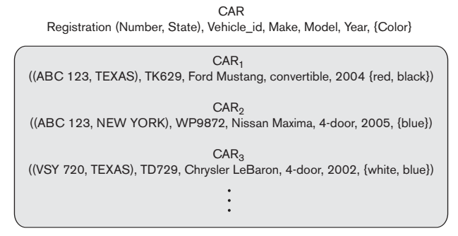
Entity Type Example

Slide 26
Take away
  Given an entity, the attributes you design should be able to describe, and the combinations of all its instances should be able to express the entity faithfully.
  This is why attribute types such as multi-valued attributes, composite attributes exist.
  Can I have an entity to describe something abstract? Of course, entities don’t have to be concrete objects. You will still need to find the right attributes to describe it.
  Relations can also have attributes

Slide 27
Entity Instances/Facts
A good entity schema should have good attributes that can be filled with good values.
Car Entity Schema:
  ((Reg. Num, State), Make, Model, Year, {Colour})
Car instance:
  (CS9311, NSW), Toyota, Toyota Corolla, 1999, {White, Silver})

Slide 28
NULL Value
What if an instance doesn’t have a value?
Examples:
    Height of a person is not known (True value is not yet known)
    A person may not have a college degree (No suitable value)
Exercise: List more cases where use of a NULL value would be appropriate.
NULL values represent attributes whose values are unknown or do not exist for some entity instance. In general, it is a special value to indicate a lack of value.

Slide 29
Keys
Key constraint in ER Modelling: in any extension of the entity type, no two entities have the same values for their key attribute or key attributes.
For example:
  {payroll number} is a key of EMPLOYEE,
  {car registration number} is a key of CAR.
All elements of a set are distinct; an entity can be defined as the set of its entity instances.
Therefore, the entity instances in an entity must also be distinct. How do we identify them? There must be a key for all entities.

Slide 30
Key
A super key is a set of one or more attributes that uniquely identify any entity instance of an entity type.
    natural (e.g., name + address + birthday)
Q: What if none of my attributes can uniquely identify my entity?
A: you can make an attribute artificially (e.g., SSN, Passport Number, etc.)
Keys containing multiple attributes as composite keys.

Slide 31
Key
Q: Technically, can’t I make an entity key to be all its attributes?
A: Since the entity is a set, in the worst case where there is no natural composite key, the set of all it’s attributes together should uniquely identify its values (strictly speaking).
Every entity must have a final candidate key: a minimal set of attributes that can uniquely identify its entity instances.

Slide 32
Key Summary
Key/Super key: a set of one or more attributes that can uniquely identify an entity instance of an entity type.
Candidate key: minimal superkey (no subset is a key)
Primary key : a candidate key chosen by DB designer
Keys are indicated in ER diagrams by underlining.

Slide 33
Weak Entity
Some entity types do not have a key of their own.
Such entity types are called weak entity types.
Entities of a weak entity type can be identified by a partial key and by being related to another entity type - owner.
The relationship type between a weak entity type to its owner is the identifying relationship of the weak entity type.

Slide 34
Weak Entity
A weak entity doesn’t have any primary key but does have a partial key (discriminator).
Partial key/discriminator: a key that is partially unique. i.e., only a subset of the attributes can be identified using it
A strong entity is an entity a regular entity where there is a primary key that uniquely identifies all instances.
Identifying relationship: the relationship type between a weak entity type to the owner of the weak entity type.

Slide 35
Example
A TAX PAYER entity may be related to several DEPENDENTS, identified by their names.
DEPENDENT is called a weak entity, {Name} is a partial key for it.
The identifying relationship between DEPENDENT and TAX PAYER is IS-DEPENDENT-OF.
TAX PAYER is said to own DEPENDENT.
SSN
Birdate
first_n
last_n
SSN
Employee
Family
m
Dependent
Fname
- - - - - -
Relation
Birdate

Slide 36
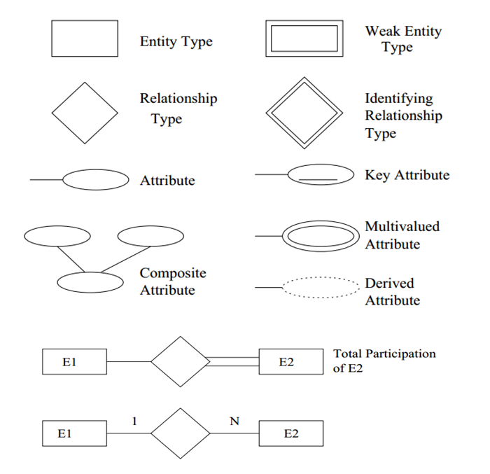
Visualizing an ER Data Model
Notations:
Notes:
TODO: Complete notations

Slide 37
Visualizing an ER Data Model
The data model can be effectively described using the Entity-Relationship Diagrams (ERDs).
Reg. Num
State
Registration
CAR
Color
Make
Model
Year

Slide 38
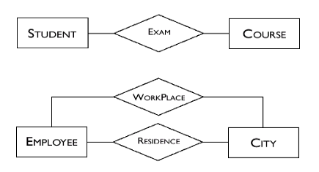
Relationship
Second Big Component of ER: They represent logical links between two or more entities.

Slide 39
Relationships
Relationships relates one entity type to another entity type.
An entity type can be related to more than one other entities, and will have a different role to play for each relationship (name each relationship to distinguish them).
An entity can also have different relationships with another entity.
Relationships can be illustrated using occurrence diagrams

Slide 40
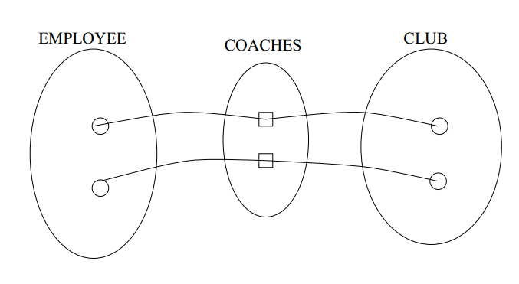
Practice
Coaches is a relationship. It’s instances describes the relation between a coach and a club.

Slide 41
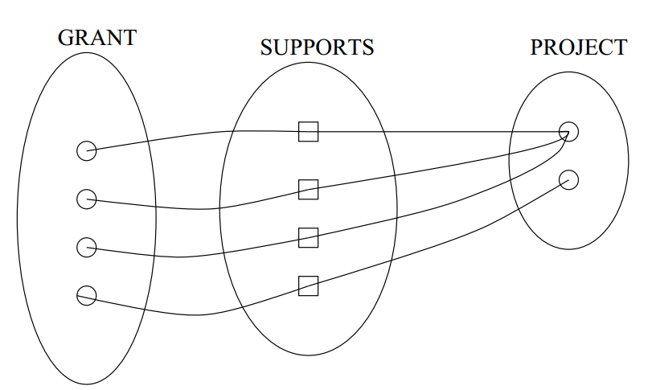
Practice
Supports is a relationship. It’s instances describe the how grants are given to projects.

Slide 42
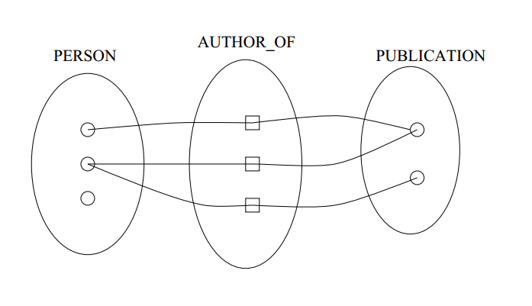
Practice
Author-of is a relationship. It’s instances describe who wrote what publication.

Slide 43
Modelling relationships
Relationship types usually have certain properties that limit the possible combinations of entities participating in relationship instances.
By default, entities can be related to other entities freely.
Are all relationships like that?
Relationship between employee and club?
Relationship between moon and planet?

Slide 44
Modelling relationships
Cardinality ratio: the number of relationship instances an entity can participate in.
There are three types of cardinality in relationship: is M:N (many to many), 1:N (one to many) is stricter, and 1:1 (one to one) is the strictest.
Example: A research grant supports only one research project, but a research project may be supported by many grants. PROJECT:GRANT is a 1 : N relationship.

Slide 45
Constraints on relationship types(cont)
We can also show this in an ERD:
SUPPORTS
GRANT
N
1
PROJECT
1
COACHES
1
EMPLOYEE
CLUB
WROTE
PERSON
N
M
PUBLICATION

Slide 46
Participation Constraint on Relationships
Question: Will each instance participate in this relationship?
For example, all university students must be enrolled to university/universities.
So far, entities don’t have to participate in the relationships they are in.

Slide 47
Participation Constraint on Relationships
Total Participation: each entity instance must patriciate in at least one relationship instance.
  Example: We want this relationship to express all publications must be written by a person.
Partial Participation: not necessarily total.
  Example: Not every person has publication
N
AUTHOR
M
PERSON
PUBLICATION

Slide 48
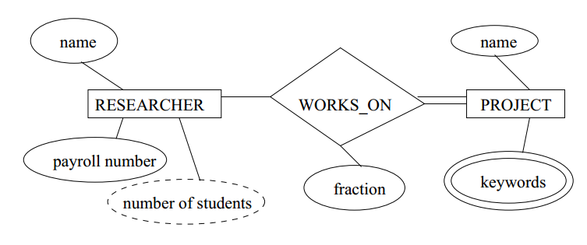
Attributes (Relationship)
A researcher may work on several projects.
The fraction of her time devoted to a particular project could be an attribute of the WORKS ON relationship type.
Q: Why not put the attribute on either researcher or project?

Slide 49
More on Relationships
Binary relationship: relationship of degree 2
Degree (of a relationship): number of participating entity types.
Lectured cover binary relationships.

Slide 50
More on Relationships
Consider the setting: relationship between RESEARCHER, STUDENT and COURSE.
ENROLMENT could be a ternary relationship (degree 3)
RESEARCHER
STUDENT
ENROLMENT
COURSE

Slide 51
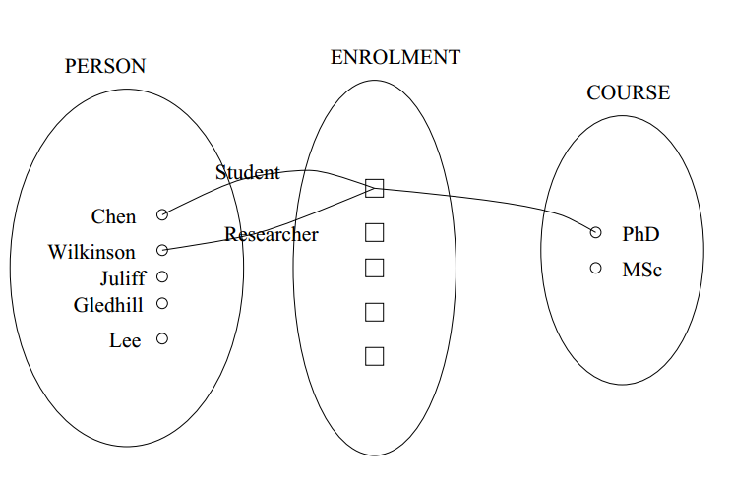
More on Relationships

Slide 52
On the Degree of a Relationship:
The more entities in a relationship, the more careful you must be when describing it. What you think your expressing may not be what the diagram means exactly.
Rule of Thumb as you are starting out: If you think you have a ternary (or higher) relationship, try decompose it to binary relationships.

Slide 53
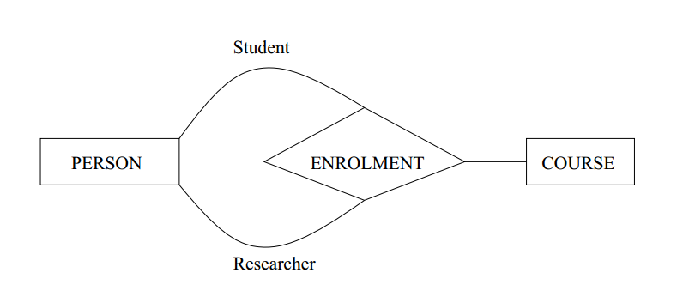
Backtrack: ENROLMENT
To make things interesting, this is another way of modelled the former.

Slide 54
Conceptual Data Modelling
Picking the right kind of entity: does it have significant properties and describe objects with independent instances?
Picking the relevant relationships: does it provide a logical link between two (or more) entities?

Slide 55
The Best Data Mode?
There is no single "best" design for a given application.
Most important aspects of a design (data model):
    correctness (satisfies requirements accurately)
    completeness (all reqs covered, all assumptions explicit)
    consistency (no contradictory statements)
    readability (easy to understand)
Potential inadequacies in a design:
  omits information that needs to be included
  contains redundant information (⇒ inconsistency)
  leads to an inefficient implementation
  violates syntactic or semantic rules of data model

Slide 56
That’s the Entity Relation Model
ER models gave us the first rules to capture the semantics
Systematically change it to Relational logical models (spoilers)
Allowed a lot of people to take a step from ‘requirements from applications’ to ‘implementing the database’

Slide 57
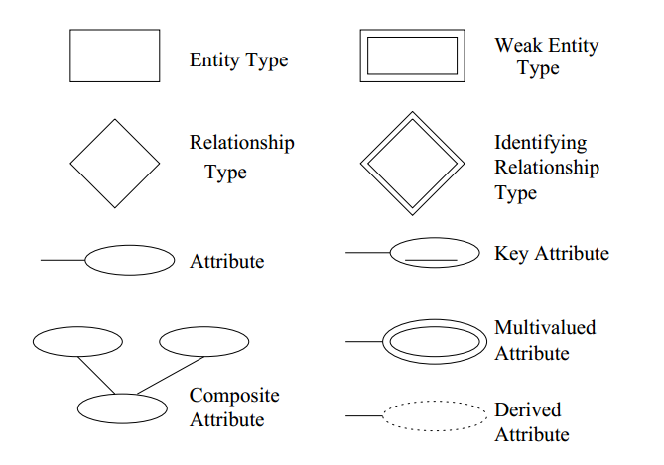
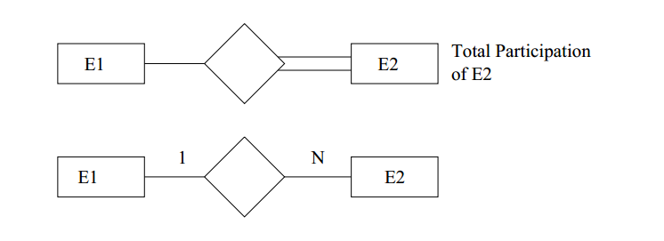
ERD Notations

Slide 58
Final Exercise: A Library Database
A book is uniquely identified by its book-id. For each book, we also record its title, price, and availability.
A reader is uniquely identified by his/her reader-id and we also record his/her name, phone number and address. The address is composed of street and suburb.
A publisher is uniquely identified by its publisher-id. For each publisher, the name is also recorded.
An author is uniquely identified by his/her author-id. For each author, the name, phone number and birth date are also recorded.
A reader can borrow zero or more books and a book can be borrowed by zero or more readers. Thus, we need to record the starting date and ending date for the borrowing relationship.
A publisher can publish zero or more books and a book is published by exactly one publisher. We also need to record the date of publication.
An author can write zero or more books and a book is written by one or more authors.

Slide 59
Final Exercise: A Library Database
A book is uniquely identified by its book-id. For each book, we also record its title, price, and availability.
A reader is uniquely identified by his/her reader-id and we also record his/her name, phone-number and address. The address is composed of street and suburb.
A publisher is uniquely identified by its publisher-id. For each publisher, the name is also recorded.
An author is uniquely identified by his/her author-id. For each author, the name, phone-number and birth-date are also recorded.
A reader can borrow zero or more books and a book can be borrowed by zero or more readers. Thus, we need to record the starting-date and ending-date for the borrowing relationship.
A publisher can publish zero or more books and a book is published by exactly one publisher. We also need to record the date-of-publication.
An author can write zero or more books and a book is written by one or more authors.

Slide 60
Exercise
A book is uniquely identified by its book-id. For each book, we also record its title, price, and availability.
A reader is uniquely identified by his/her reader-id and we also record his/her name, phone-number and address. The address is composed of street and suburb.
A publisher is uniquely identified by its publisher-id. For each publisher, the name is also recorded.
An author is uniquely identified by his/her author-id. For each author, the name, phone-number and birth-date are also recorded.
A reader can borrow zero or more books and a book can be borrowed by zero or more readers. Thus, we need to record the starting-date and ending-date for the borrowing relationship.
A publisher can publish zero or more books and a book is published by exactly one publisher. We also need to record the date-of-publication.
An author can write zero or more books and a book is written by one or more authors.
Entity focused
Relation focused

Slide 61
Exercise (1/7)
A book is uniquely identified by its book id. For each book, we also record its title, price, and availability.
title
price
availability
id
book

Slide 62
Exercise (2/7)
A reader is uniquely identified by his/her reader id and we also record his/her name, phone number, dob and address. The address is composed of street and suburb.
id
name
number
street
address
reader
suburb

Slide 63
Exercise (3/7)
A publisher is uniquely identified by its publisher id. For each publisher, the name is also recorded.
publisher
id
name

Slide 64
Exercise (4/7)
An author is uniquely identified by his/her author id. For each author, the name, phone number and birth date are also recorded.
author
id
name
number
birthday

Slide 65
Exercise (5/7)
A reader can borrow zero or more books and a book can be borrowed by zero or more readers. Thus, we need to record the starting date and ending date for the borrowing relationship.
book
m
reader
n
borrow
starting date
ending date

Slide 66
Exercise (6/7)
A publisher can publish zero or more books and a book is published by exactly one publisher. We also need to record the date of publication.
book
n
publish date
publish
1
publisher

Slide 67
Exercise (7/7)
An author can write zero or more books and a book is written by one or more authors.
book
m
n
author
write

Slide 68
Full Sample Solution
id
name
number
title
price
availability
id
street
m
address
book
borrow
reader
n
n
suburb
publish date
publish
starting date
ending date
m
1
n
author
publisher
write
id
name
id
name
number
birthday

Slide 69
Summary
A high level process that converts applications into a data model
describe the information in a way that is suitable for database implementation (e.g., entities: students, courses, accounts, branches, patients, ...)
describe how information is related (e.g., John is enrolled in COMP3311, Andrew's account is held at Comm Bank)

Slide 70
Learning Outcome:
Given application requirements, how to ER-diagram to accurately reflect the application (and all the specific requirements).
Understand ER model as a solution for expressing any application requirement.
NOTE: You must use the notation in the lecture for this course.

